Slide 1
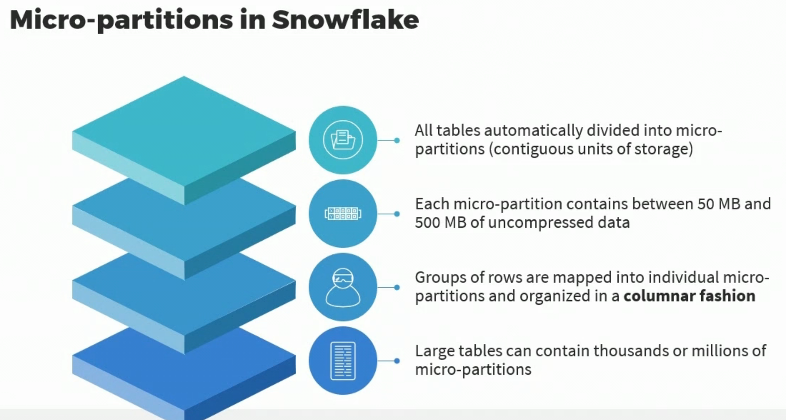

Slide 2
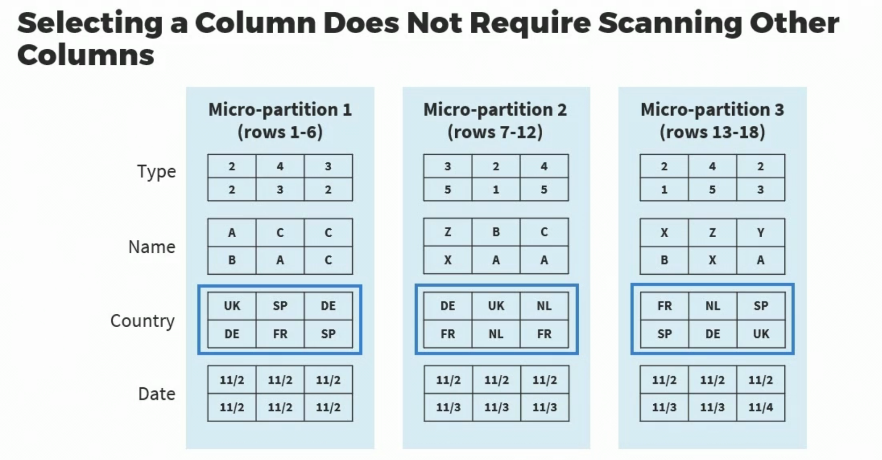
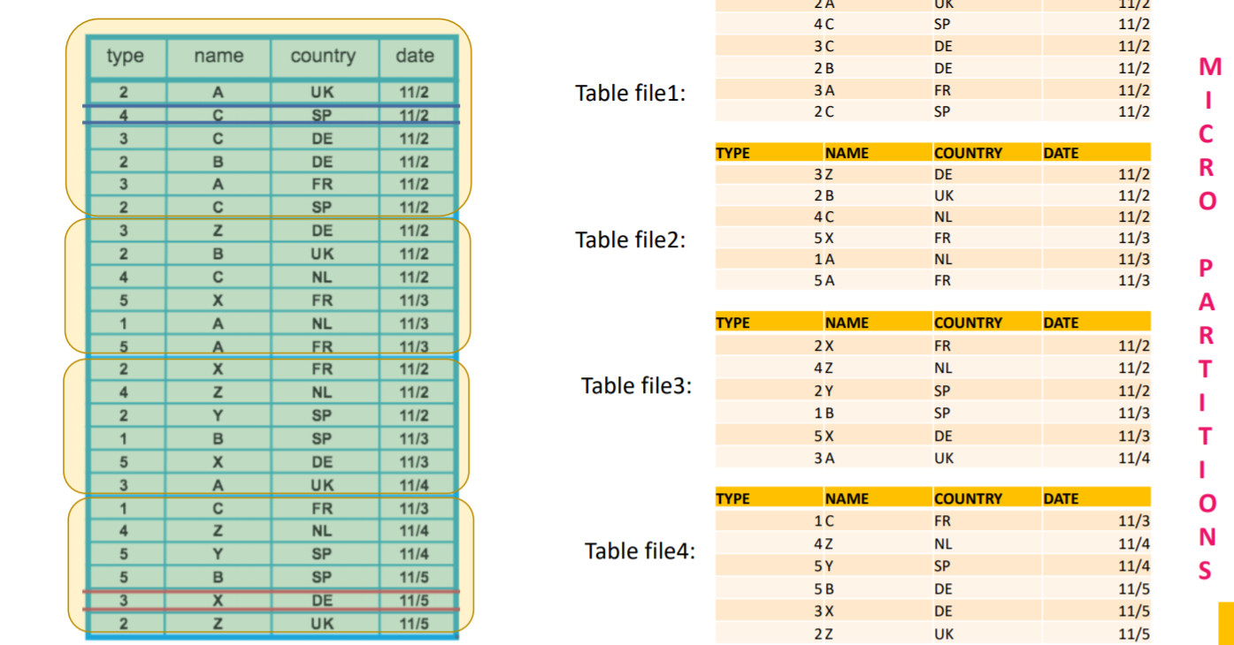
Micro Partitions: All data in Snowflake tables is automatically divided into micro-partitions, which are contiguous units of storage. Each micro-partition contains between 50 MB and 500 MB of compressed data (note that the actual size in Snowflake is smaller because data is always stored compressed)..

Slide 3
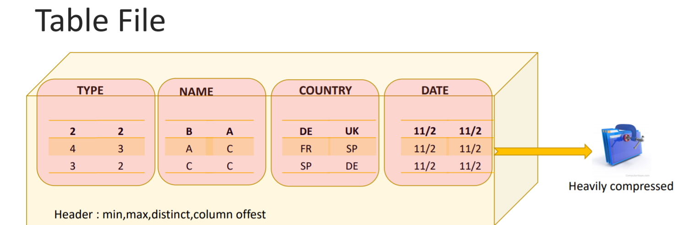
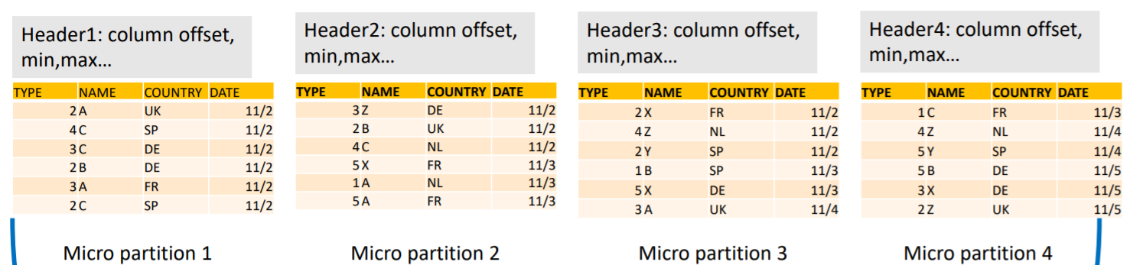
Second, Reorganize the data in each partition to make it columnar i.e. Column values in partition are stored together.Also compress the data automatically.
Finally, they add header to each partition,whch contains offset and length of each column stored within partition.

Slide 4
Finally, these micro partitions stored on S3 in the form of immutable files while other statistics and information about these partitions are stored at cloud service layer
Note: While loading the data into table,Snowflake does not reorganize the micro partitions,once the data load completed snowflake rorganized the micro partitions

Slide 5
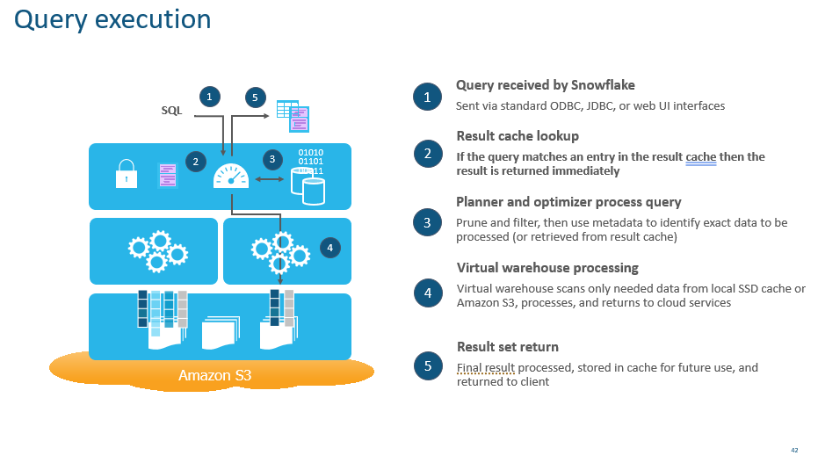

Slide 6
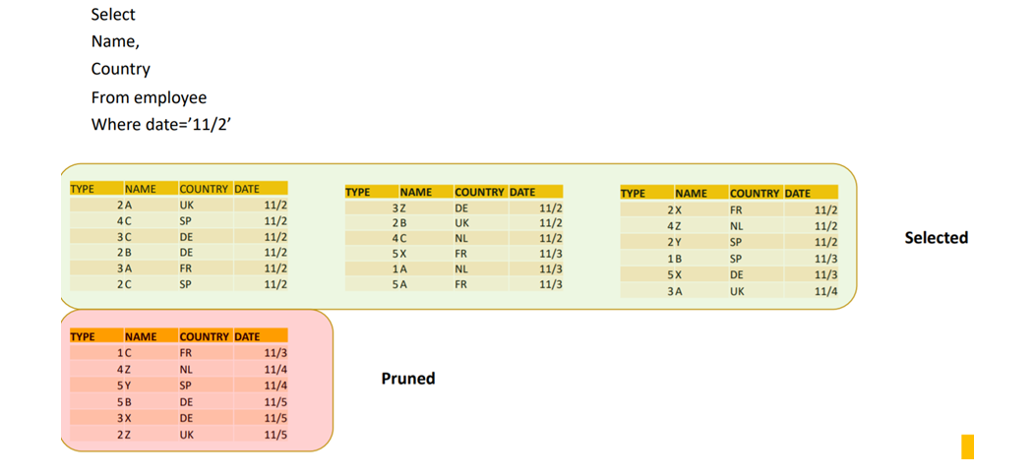
During the Query processing:
Nodes will first download the tablefile header from all the table files.
Based on the metadata information in the header file, Micro partitions are scanned, and this allows the first level of partition pruning
In next step read the micro partition header and read the desired columns and this allows the second level of column pruning

Slide 7
Clustering:
Snowflake supports the idea of Cluster Keys, Used to help keep all frequently accessed data in the same micro-partition for faster retrieval.
What is Snowflake Clustering Key? A clustering key is a subset of columns in a table that are explicitly used to co-locate the data in the table in the same micro-partition. This is useful for very large tables where query execution takes time. The more frequently a table is queried, the more benefit clustering provides. However, the more frequently a table changes, the more expensive it will be to keep it clustered
In general, if a column (or expression) has higher cardinality, then maintaining clustering on that column is more expensive.
Snowflake recommends a maximum of 3 or 4 columns (or expressions) per key. Adding more than 3-4 columns tends to increase costs more than benefits.

Slide 8


TABLES AND CLUSTERING KEYS
Clustering keys are not for every table!
All tables have a “natural” clustering based on ingestion order
A single data load reads source data and writes it into some number of micro-partitions
Automatic clustering consumes credits
Reclustering also increases storage costs
Can be less expensive to add cluster key after loading the table
Automatic Clustering can be disabled
Natural clustering can be overridden by designating clustering keys
The source data organization determines what range of values are represented in the micro-partitions
Clustering keys can be columns or expressions
Use 1-3 keys maximum, in order of low to high cardinality
A single data load reads source data and writes it into some number of micro-partitions
Good candidates for clustering keys:
Tables in the multi-terabyte range experience the most benefit from clustering (particularly if DML is performed regularly on these tables)
Tables that change infrequently are less expensive to recluster
Tables whose query performance degrades noticeably over time
After clustering, like data (by key) is co-located in the same micro-partitions
Source data contains rows from a specific day: that day's data will be in contiguous micro-partitions
Source data contains rows for a month or year: those micro-partitions will have high/low values for dates within that month or year
Source data is ordered alphabetically on a "last name" column: contiguous micro-partitions will be in alphabetical order
Snowflake keeps the clustering order updated in the background, billed on a per-second basis
© 2020 Snowflake Inc. All Rights Reserved
Notes:
20E071624:perf_clustering_L1.pptx:4
Sometimes the natural clustering for a table does not work well for the queries you end up running against it. One option for this is the unload the table, re-order it, and then re-load it. It will be better clustered, but the natural clustering will still degrade over time.
A clustered table is on that you have specifically designated to be clustered on particular columns or expressions. Clustering keys define what your table will be clustered on. After re-clustering, the keys are co-located in the same micropartitions

Slide 9
CLUSTERING COMMAND SAMPLES
CREATE TABLE t1 (c1 date, c2 string, c3 number) CLUSTER BY (c1, c2);
CREATE TABLE t2 (c1 timestamp, c2 string, c3 number) CLUSTER BY (TO_DATE(c1), SUBSTRING(c2, 0, 10));
ALTER TABLE t1 CLUSTER BY (c1, c3);
ALTER TABLE t2 CLUSTER BY (SUBSTRING(c2, 5, 10), TO_DATE(c1));
© 2020 Snowflake Inc. All Rights Reserved
Notes:
20E071624:perf_clustering_L1.pptx:6
Here are some commands for defining clustering keys. Note that you can specify clustering keys when the table is created, or after the fact by using ALTER TABLE. Also, you can specify columns as clustering keys, or expressions such as TO_DATE or SUBSTRING.

Slide 10
WHAT TABLES SHOULD BE CLUSTERED?
Clustering keys are not for every table!
Automatic clustering consumes credits
Reclustering also increases storage costs
Good candidates for clustering keys:
Tables in the multi-terabyte range
Query performance degrades noticeably over time
Keep in mind:
Frequently-changing tables are more expensive to cluster
Automatic clustering can be suspended and resumed
© 2020 Snowflake Inc. All Rights Reserved
Notes:
20E071624:perf_clustering_L1.pptx:5
It sounds great - and it is - but that doesn't mean you want to cluster every table in your system. Automatic cluster consumes credits because it requires compute. The larger the table, the more credits will be consumed for the initial clustering and re-clustering.
Re-clustering also increases your storage costs. Remember, whenever a table is updated, new micr-partitions are created - and the original ones are kept in the system for Time Travel and fail-safe storage. For tables that change frequently, re-clustering can

Slide 11
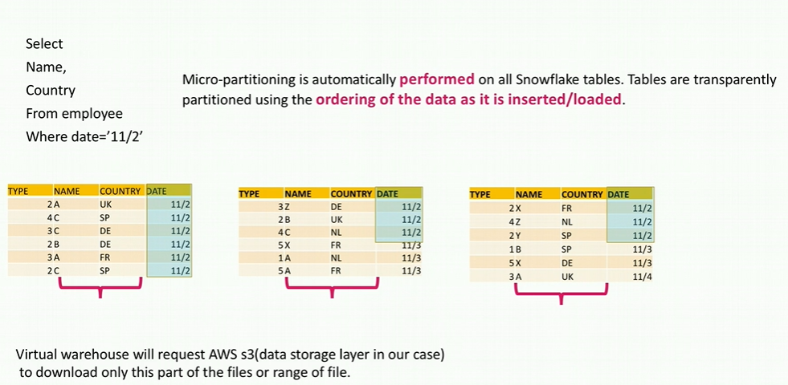
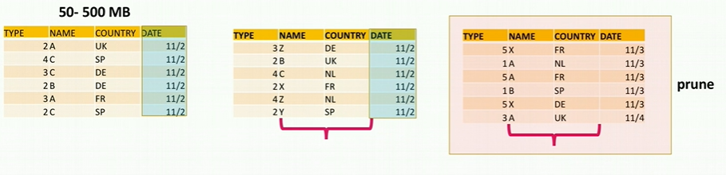
Clustering Example:
Ideal scenario is 11/2 should be in
Second partition and hence reading
the 3rd partition would be eliminated

Slide 12
Reclustering:
As DML operations (INSERT, UPDATE, DELETE, MERGE, COPY) are performed on a clustered table,
the data in the table might become less clustered. Periodic/regular reclustering of the table is required to maintain
optimal clustering.
During reclustering, Snowflake reorganize the column data, so that related records are relocated to the same micro-partition.
Reclustering in Snowflake is automatic; no maintenance is needed.
Similar to all DML operations in Snowflake, reclustering consumes credits.
The number of credits consumed depends on the size of the table and the amount of data that needs to be reclustered.

Slide 13
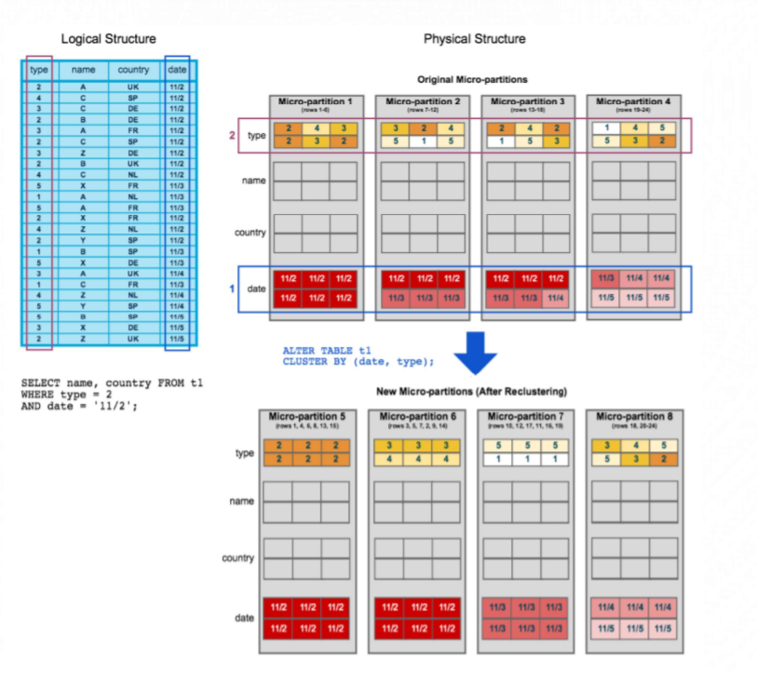
To start, table t1 is naturally clustered by date across micro-partitions 1-4.
The query (in the diagram) requires scanning micro-partitions 1, 2, and 3.
date and type are defined as the clustering key. When the table is reclustered, new micro-partitions (5-8) are created.
After reclustering, the same query only scans micro-partitions 5 and 6.

Slide 14
Snowflake Clustering Best Practice
It is however, not sensible to simply place clustering on every table in the database. You should use the following best practice guidelines:
If it aint broke: Clustering happens in background and is charged for the sorting. Balance the cost of clustering against the benefits in partition elimination. If you don't have a query performance issue, or the clustering is not helping, then don't use it.
Deploy on Large Tables: There's no point clustering small tables. Snowflake recommend clustering tables over a terabyte in size. In reality, consider anything above 100-200 GIGS, but base your decison upon the need to improve partition elimination.
Choose your key wisely: Clustering physically sorts the data, which means you only get one key (with possible sub-keys). Choose a cluster key that appears frequently in query WHERE clauses, as this will have the greatest impact upon partition elimination and therefore query performance improvements.
Composite Keys: Are fine, for example you could cluster by DATE and REGION, but experience shows adding additional keys increase the cost of clustering, but have a reduced improvement in partition elimination.
Be cautious using functions against predicates: By all means, if you define a cluster key using a function (for example to convert a timestamp to a date) then you should use the same function in your where clause. However, avoid using functions against columns if possible as these tend to be ignored for the purposes of partition elimination.

Slide 15
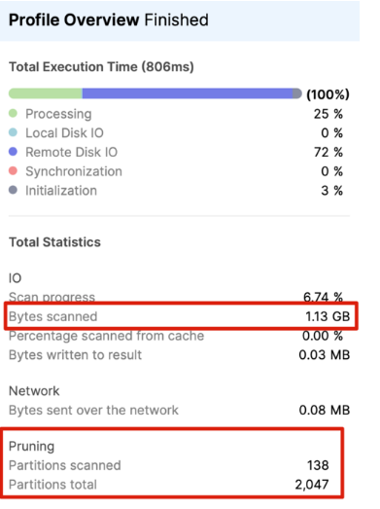
Avoid using functions against WHERE clause predicates
select * from monitor_query_history where execution_status = 'SUCCESS' AND warehouse_size IS NOT NULL AND to_char(start_time,'YYYYMMDD') >= '20210620' AND to_char(start_time,'YYYYMMDD') <= '20210720' and bytes_scanned > 0 limit 100;
ALTER TABLE T1 CLUSTER BY (START_TIME)

Slide 16
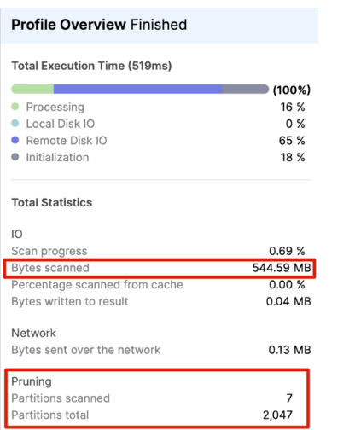
Now compare the above to the following SQL which returns exactly the same result, but much faster.
select * from monitor_query_history where execution_status = 'SUCCESS' AND warehouse_size IS NOT NULL AND start_time >= '2021-06-20' AND start_time <= '2021-07-20' and bytes_scanned > 0 limit 100;
As you can see, the second query which avoided the function against the START_TIME column scanned 20 times fewer micro-partitions

Slide 17
Dynamic Masking
Column masking (sometimes referred to as data masking) lets you assign the MASKED attribute to columns so that unprivileged users cannot view the data. Snowflake’s dynamic data masking played a major role in protecting sensitive information by masking the data and change the actual values of data in encrypted form and thus restrict the unauthorized user inorder to get access actual sensitive information i.e Personally identifiable information (PII) about the customer.
After creating a masking policy, apply the masking policy to a column in a table or view using ALTER TABLE … ALTER COLUMN or ALTER VIEW
Snowflake evaluates the masking policy as a SQL expression. Therefore, rules are evaluated in the order they are written if specified as WHEN-THEN clauses in a CASE expression in the masking policy body.

Slide 18
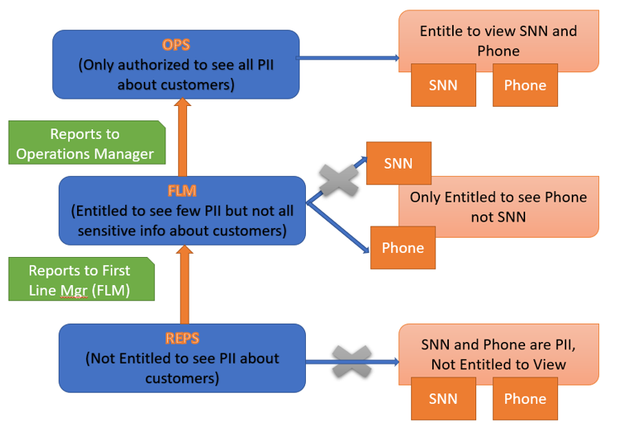
Dynamic Masking Use Case:
Consider the multilevel hierarchy to implement the Column Masking:
REPS : collection Representative who talks to the Customer to recover the amount
FLM : First Line Manager where REPS reports to FLM
OPS: Operational Manager : FLM reports to OPS
REPS--> FLM ---> OPS
Where REPS ,First level not authorized to view Customer Phone number and SSN ,
While the FLM ,above in the Hierarchy is authorized to access only Phone number as he/she can make a call to customer in case of issue but not SSN number which is confidential.
OPS the top most in hierarchy only authorized to access both Phone as well SSN number.

Slide 19
Row Masking
After the introduction of Dynamic Data Masking, which enhances column-level security, Snowflake has enabled Row Access Policies feature, which enhances row-level security in the Data Cloud. To meet the compliance and data security standards , governance teams want to ensure that users can view only column-level and row-level data that they are authorized to access. Snowflake supports row-level security through the use of row access policies to determine which rows to return in the query result.
We can can include conditions and functions in the policy expression to transform the data at query runtime when those conditions are met.
Row access policies do not restrict the ROWS to be inserted into the table, or prevent visible rows from being updated or deleted.They have control the data visibility not on the DML side.
When a database object has both a row access policy and column masking policies, Snowflake evaluates the row access policy first. .

Slide 20
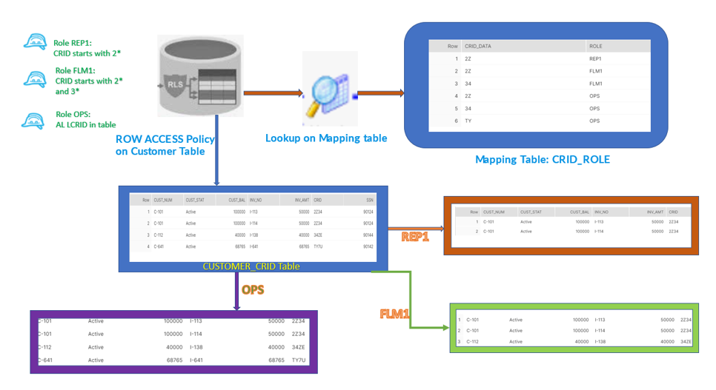
Row Masking Use Case:
According to the above diagram, We have multiple records in CUSTOMER_CRID table belongs to the different type of CRID i.e. 2*,3*,T*.
As per the requirement, REP which is lower in hierarchy is authorized to access only the data whcoh belongs to CRID 2*.
FLM superior in hierarchy to the REP should be authorized to access 2* and 3* as well but not the T* CRID data.
OPS the top most in hierarchy should have access to all the data in Customer CRID table.

Slide 21
THANKS

